Slide 1
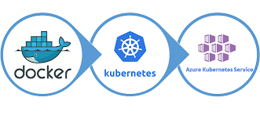
Azure Kubernetes Service
Introduction
Managed K8S
Container Orchestration
Microservices-based applications
stateless and stateful applications
Identity
Virtual Networking
Preferred programming language
Operational overhead of managing Kubernetes
Only pay for the agent nodes
Computation

Slide 2
Azure Kubernetes Service
Introduction
Azure Kubernetes Service offers portal, command line
Flexible deployment options
Identity and security management
Integrated logging and monitoring
Features
Virtual Networking
Cluster node scaling
Cluster node upgrades
HTTP application routing
Computation

Slide 3
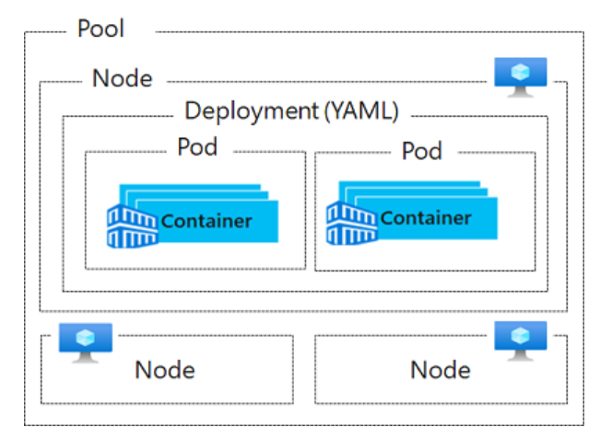
Azure Kubernetes Service
Pools are groups of nodes with identical configurations.
Nodes are individual virtual machines running containerized applications.
Pods are a single instance of an application. A pod can contain multiple containers.
Container is a lightweight and portable executable image that contains software and all of its dependencies.
Deployment has one or more identical pods managed by Kubernetes​.
Manifest is the YAML file describing a deployment.
.
Introduction
Features
Terminology
Computation

Slide 4
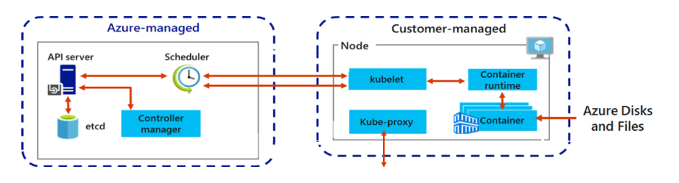
Azure Kubernetes Service
Introduction
A Kubernetes cluster is divided into two components:
Azure-managed nodes, which provide the core Kubernetes services and orchestration of application workloads.
Customer-managed nodes that run your application workloads.
Features
Terminology
Computation

Slide 5

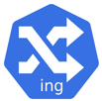
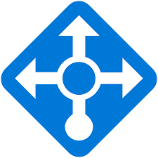
Azure Kubernetes Service
Introduction
Kubernetes provides an abstraction layer to virtual networking. Kubernetes nodes are connected to a virtual network.
Features
kube-proxy
Ingress Controllers
Networking
Computation
Azure load balancer

Slide 6
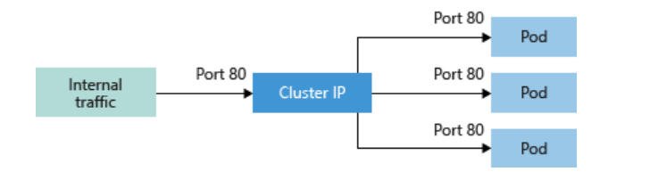
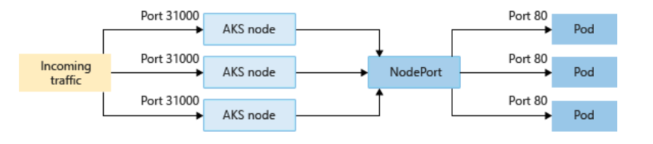
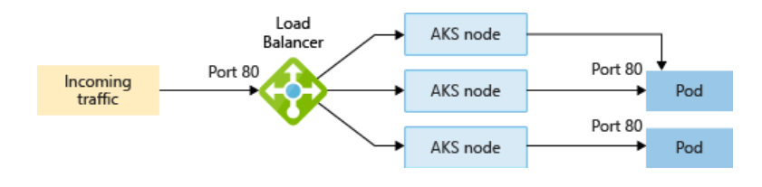
AKS - Service
Introduction
Cluster IP
Features
Node Port
Networking
Computation
Load Balancer

Slide 7
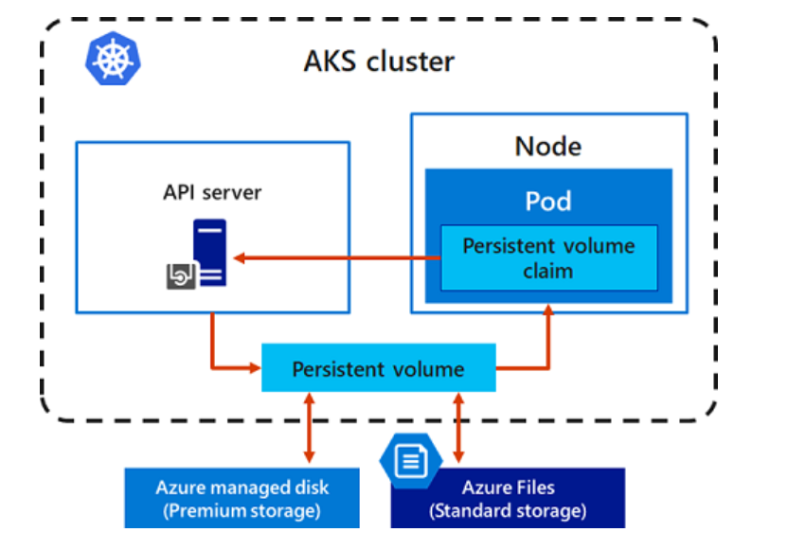
Azure Kubernetes Service
Introduction
Applications that run in Azure Kubernetes Service (AKS) may need to store and retrieve data. For some application workloads, this data storage can use local, fast storage on the node that is no longer needed when the pods are deleted
Features
Networking
Computation

Slide 8
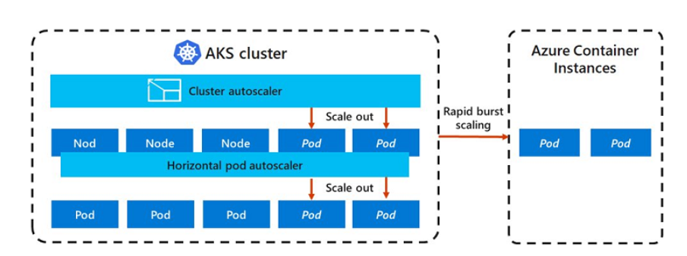
AKS Scaling to ACI
Introduction
To rapidly scale your AKS cluster, you can integrate with Azure Container Instances (ACI). Kubernetes has built-in components to scale the replica and node count
Features
Networking
Computation

Slide 9

DEMO
Introduction
Features
Networking
Computation

Slide 10
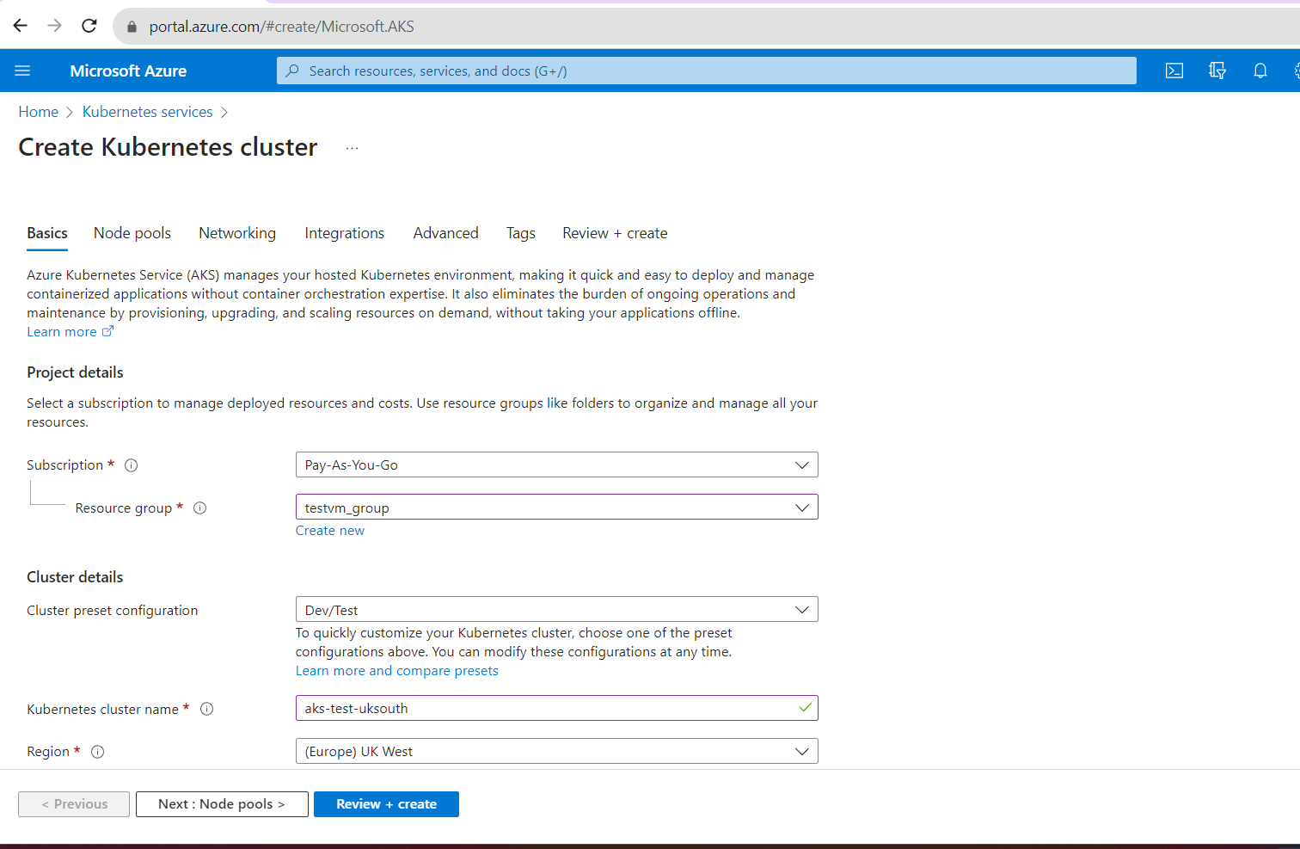

Slide 11
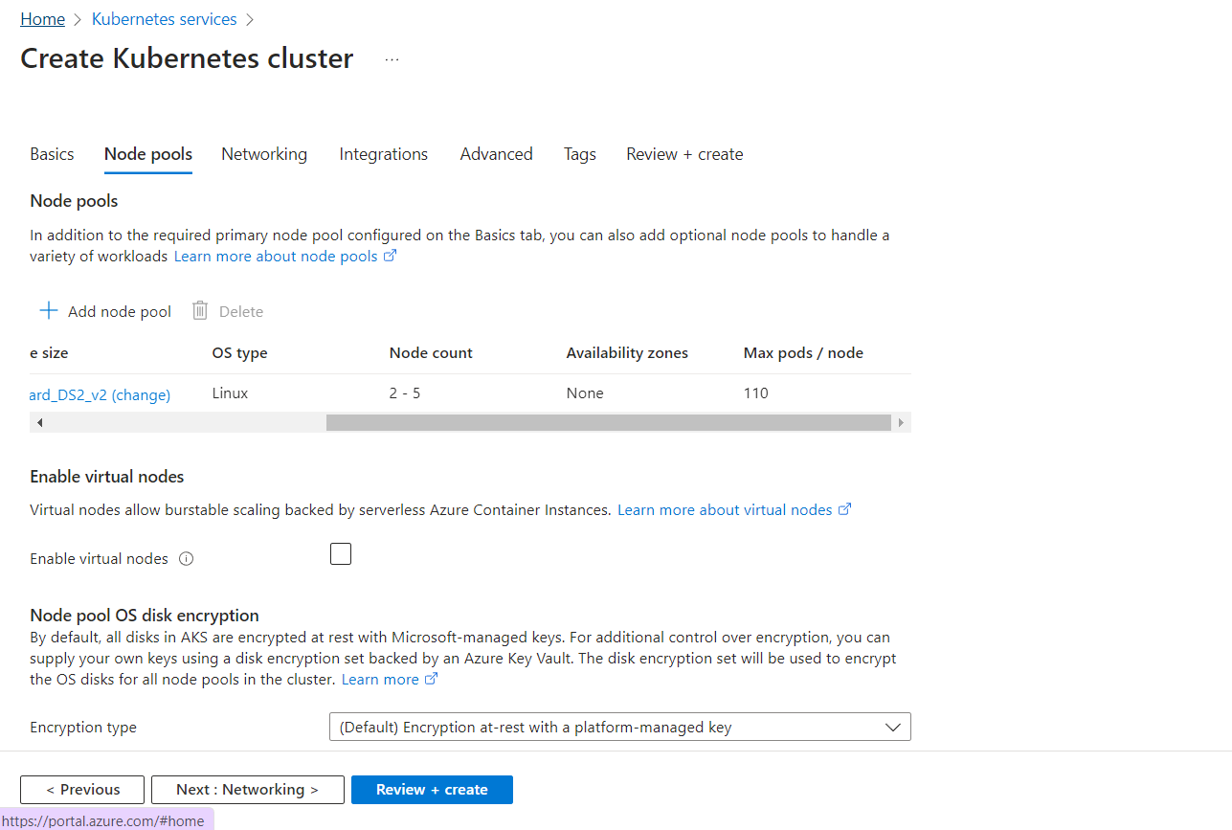

Slide 12
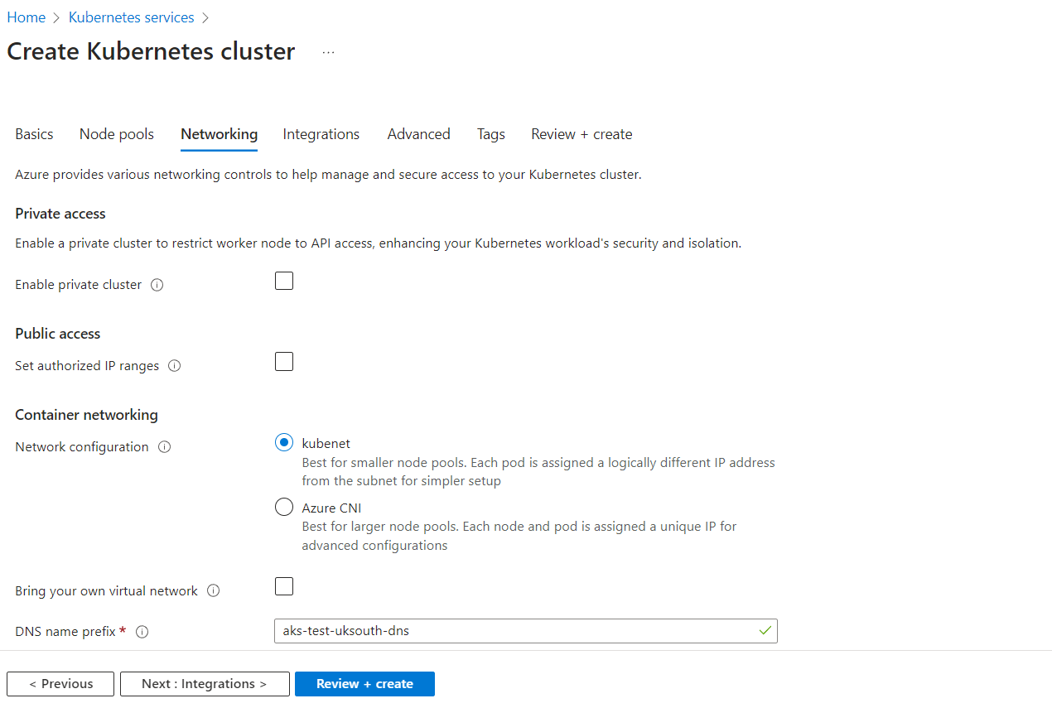

Slide 13
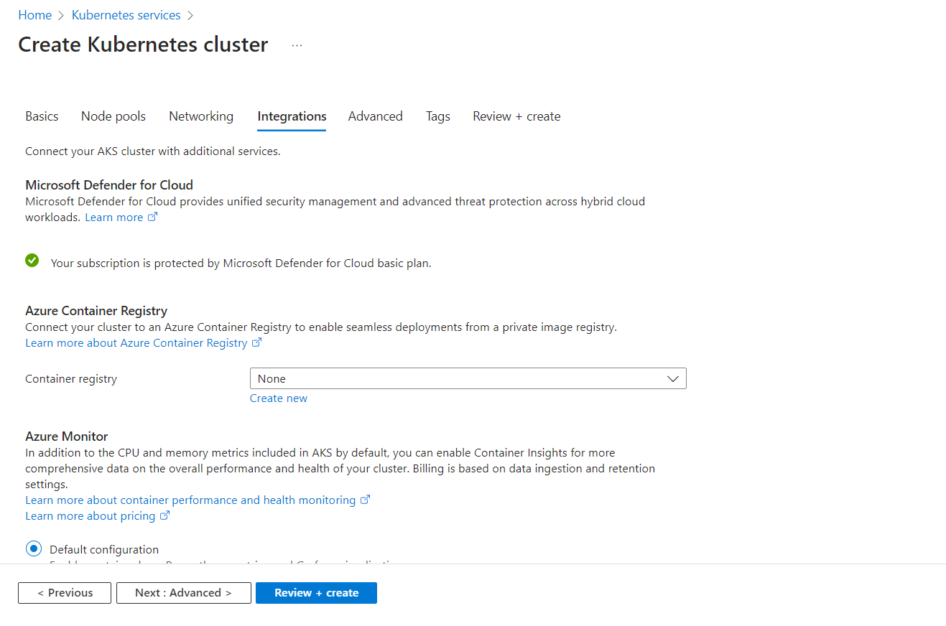

Slide 14
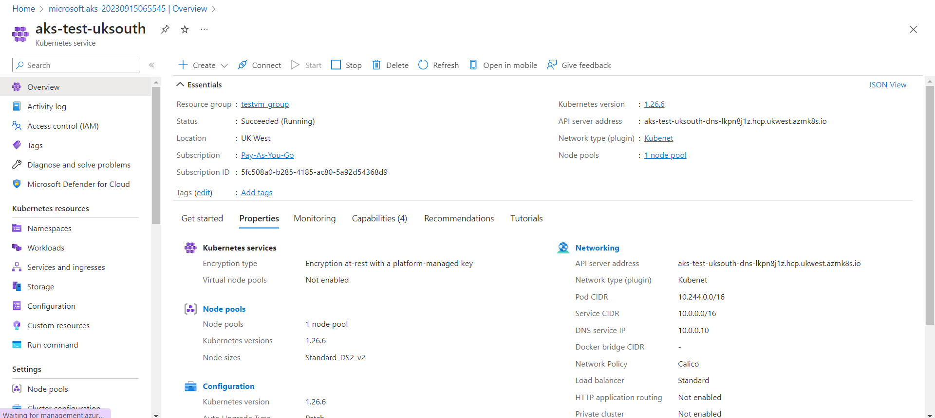

Slide 15
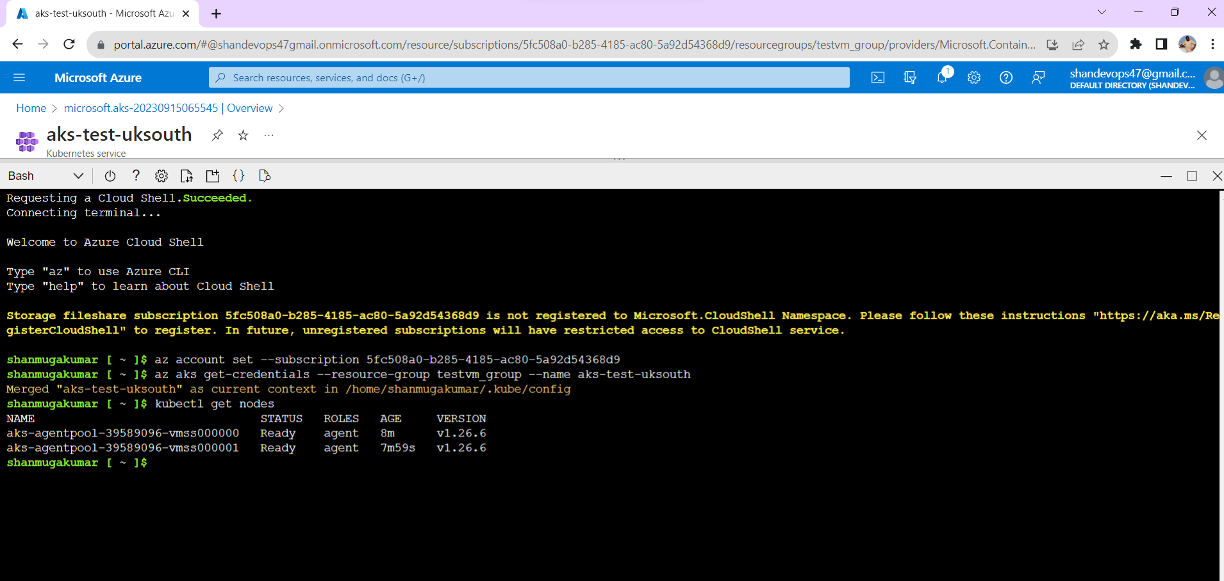

Slide 16
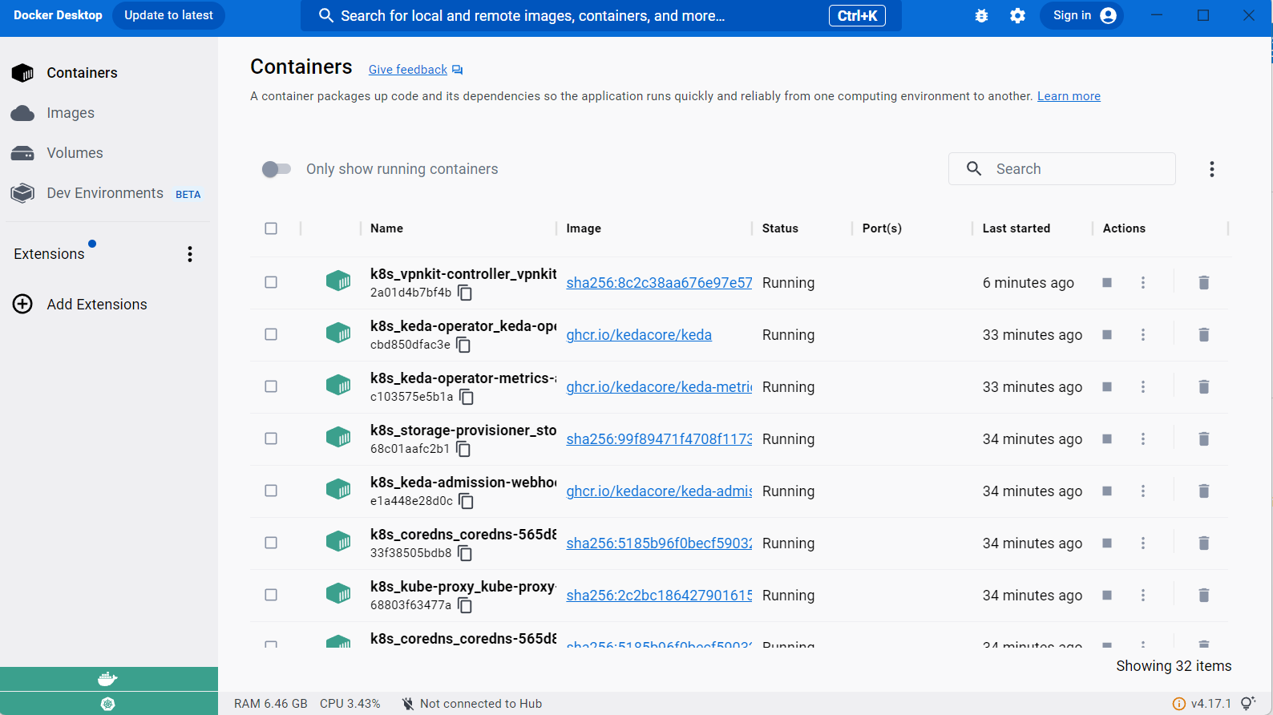

Slide 17
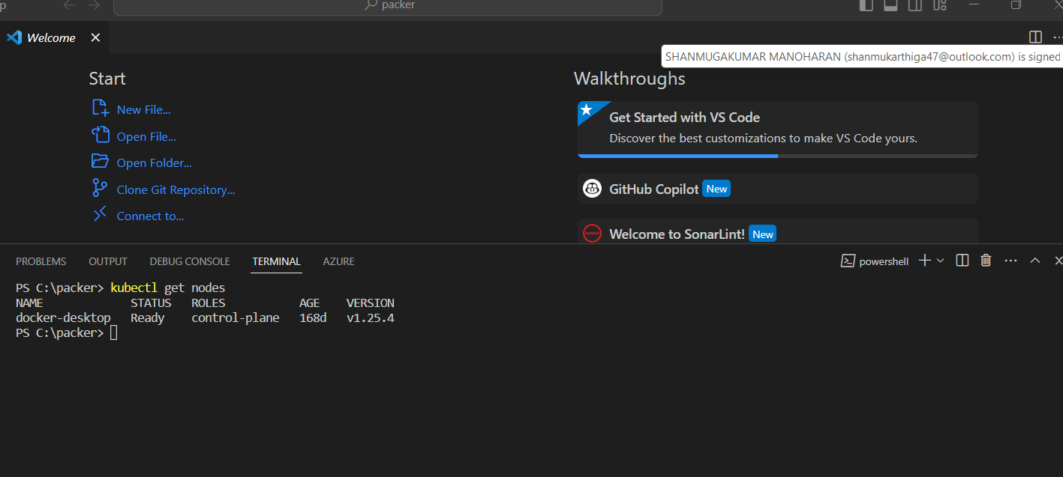

Slide 18
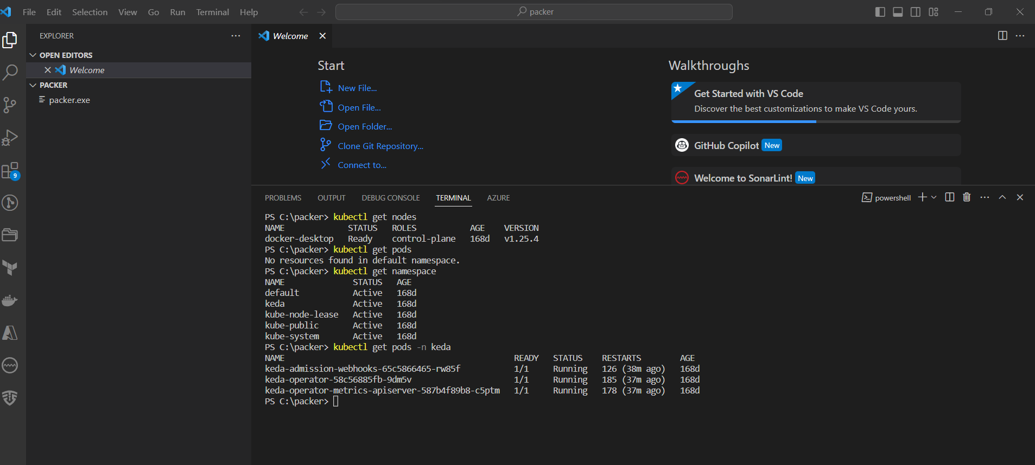

Slide 19

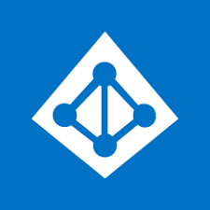
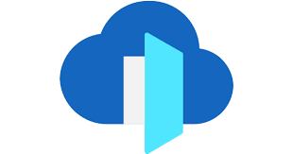





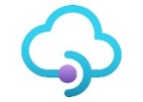
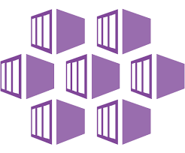
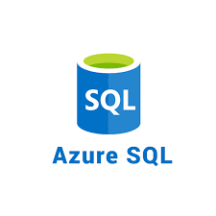
Users
Azure AD
Azure Front Door
Azure DNS
Primary Region
Secondary Region
Application Gateway
App Gateway
Application Gateway
Presentation Layer
App Services
App Services
API Layer
APIM
APIM
Business logic Layer
AKS
AKS
DataBase layer

